Slide 1
Seven Trees, Seven Practices
Mark Acosta, Bob Barber, Jesse Bamba, Joe Tuqero, Phoebe Wall

Slide 2
Seven Practices
Sheet Mulching
Drip Irrigation
Fruit Tree Windbreaks
Contour Farming
NFT Hedgerows
Filter Strips
Green Manures and Cover Crops

Slide 3
Sheet Mulching
It is a 3 layer mulch system used to grow plants.
Sheet mulching has a weed barrier which is a thick biodegradable material that blocks weeds from sunlight, while allowing water to get through.
Simple, low maintenance practice that produces healthy, productive soil, and keeps the garden free of weeds.
Uses easily accessible materials (such as cardboard, shredded paper, newspaper, grass clippings, green-waste, etc.)

Slide 4
Sheet Mulching: Three Layers
Concentrated nutrient layer
This is the high organic matter area for plant root growth
Weed barrier
Cardboard is best but newspaper or paper bags work
Mulch/Compost layer
This is where you pile up organic matter to break down for future nutrient layer

Slide 5
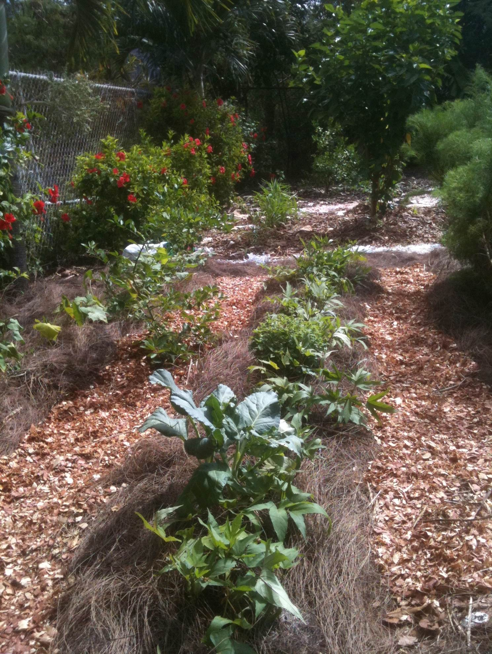
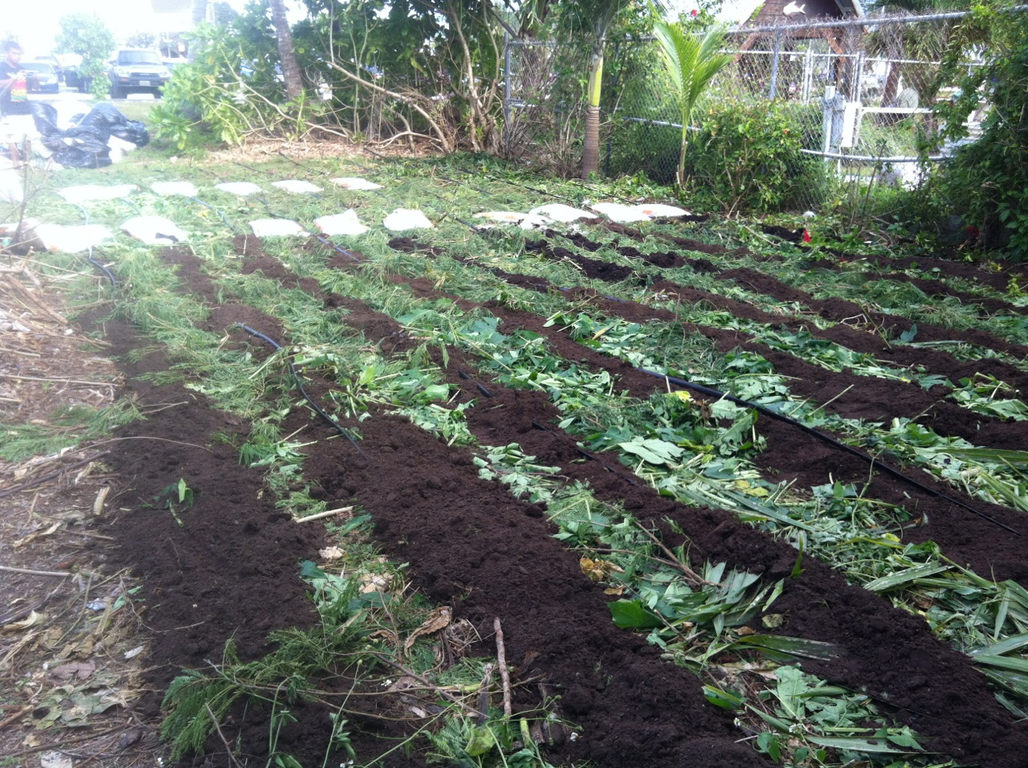
Sheet Mulching

Slide 6
Micro Irrigation
Usually refers to
Drip irrigation
Smaller spray/sprinkler and mist
Irrigation
The supply of water to land or crops typically by artificial means.

Slide 7
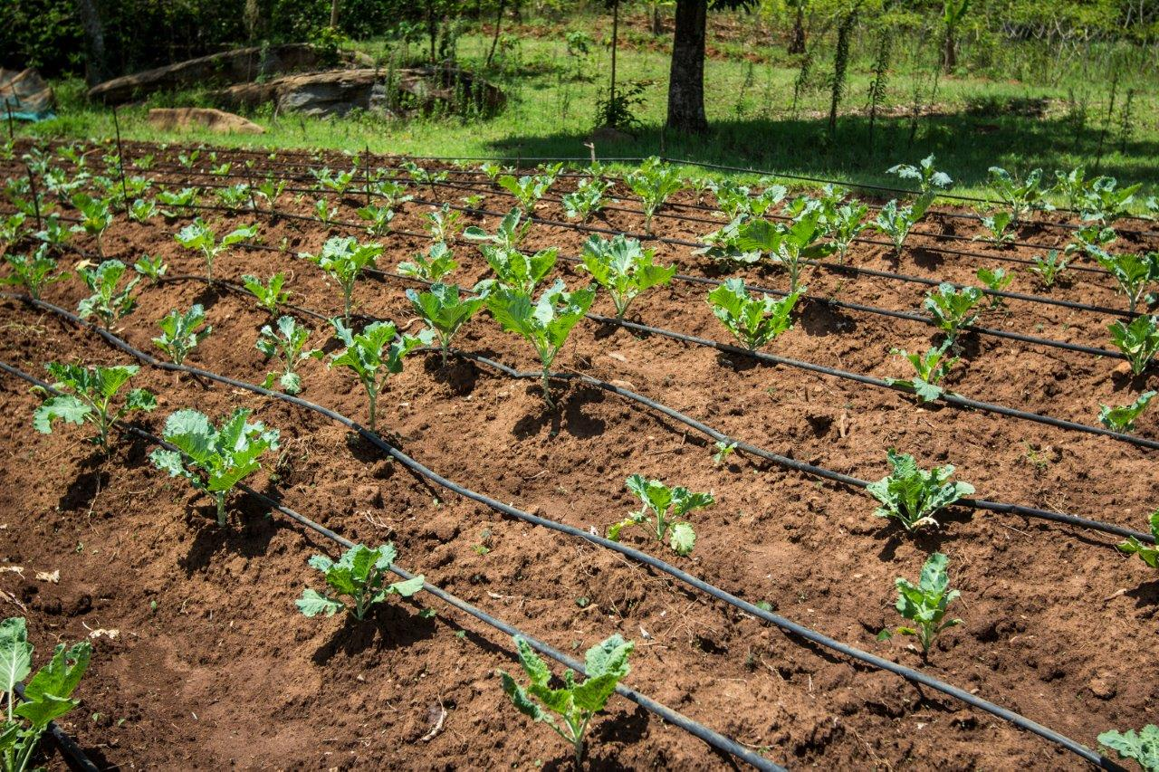
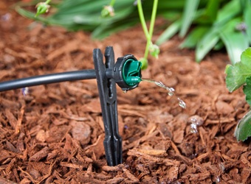
Common Irrigation Techniques
Drip-irrigation
Drip tape / Drip - line
Button emitter / Bubbler
https://www.agrilinks.org/blog/introducing-drip-irrigation-technologies-smallholder-farmers
https://www.dripirrigation.com/1-gph-button-drip-emitter

Slide 8
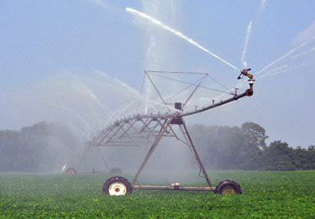
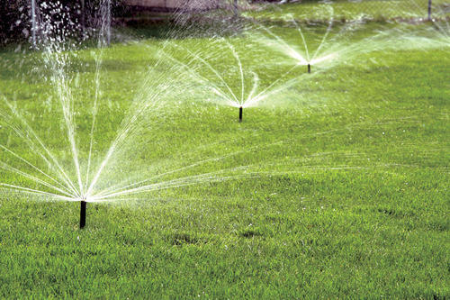
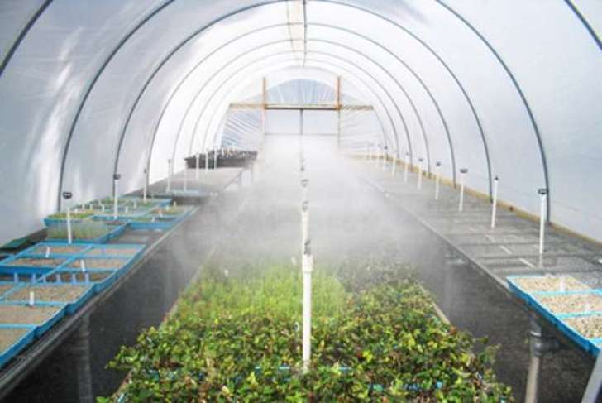
Common Irrigation Techniques
Spray/Sprinkler/Mist Irrigation
https://water.usgs.gov/edu/irsprayhigh.html
https://www.indiamart.com/proddetail/sprinkler-irrigation-system-14061781491.html
https://english.mathrubhumi.com/agriculture/agri-news/keep-plants-cool-with-mist-irrigation-system-english-news-1.1222129

Slide 9
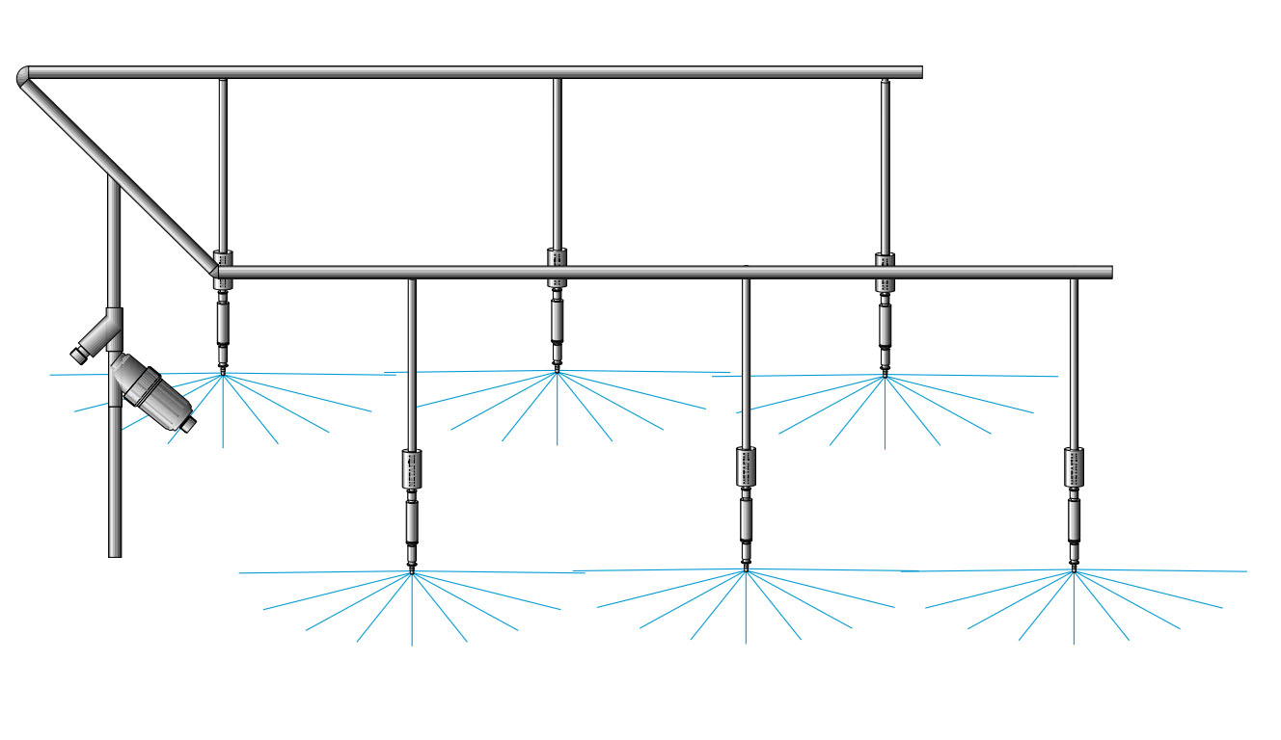
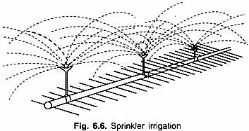
Mist or sprinkler Basic Design
http://cdn.yourarticlelibrary.com/wp-content/uploads/2015/06/image693.png
https://www.aisgreenworks.com.au/water-systems/overhead-sprinklers/#iLightbox[963b385300d8ea72fae]/0

Slide 10
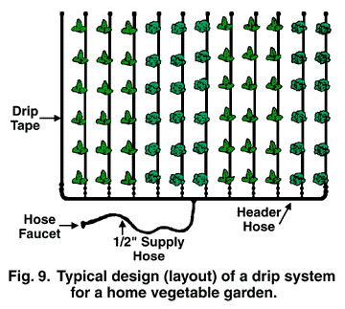
Basic Field Layout of Drip Tape/Bubbler Irrigation System
https://aggie-horticulture.tamu.edu/earthkind/drought/efficient-use-of-water-in-the-garden-and-landscape/

Slide 11
Why Use Drip Irrigation?
Pros:
Even/Accurate watering – Efficent
Improves plant growth and development
Timely mannered watering
Less labor
Reduce water waste/ersosion/run-off - Conservation
Cons:
Can be costly up front
Not all parts always ready available in our region
System needs to be maintained and cleaned frequently
Lines get clogged
If not installed correctly contaminants (if used for fertilizing/pesticide application) can enter main waterline

Slide 12
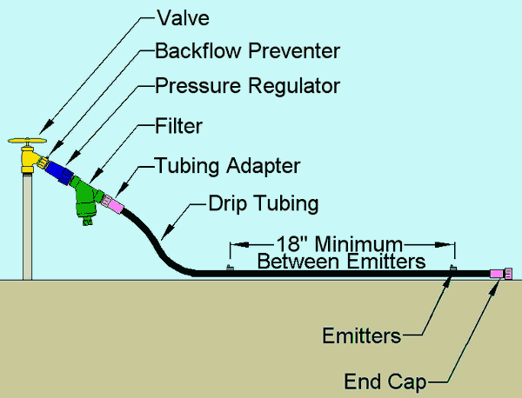
Basic Components of Micro-Irrigation System (Drip and Sprinkler/mist systems)
https://www.irrigationtutorials.com/drip-system-basic-parts-valves-backflow-preventers-filters-tubing-emitters-and-more/

Slide 13
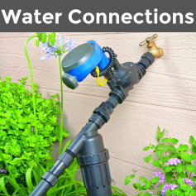
Basic Components of Micro-irrigation Drip-line system (common faucet)
https://www.dripirrigation.com/

Slide 14
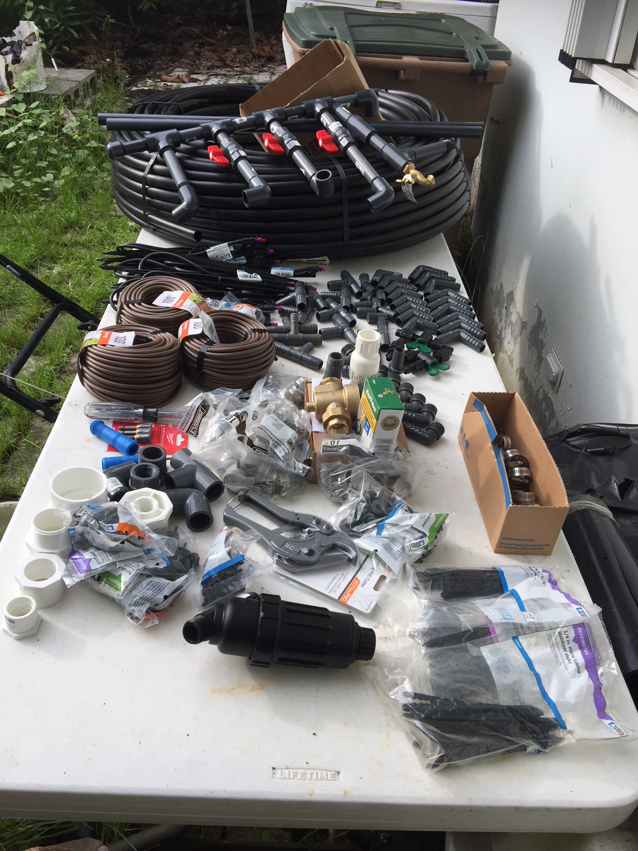
Drip Tape Installation

Slide 15
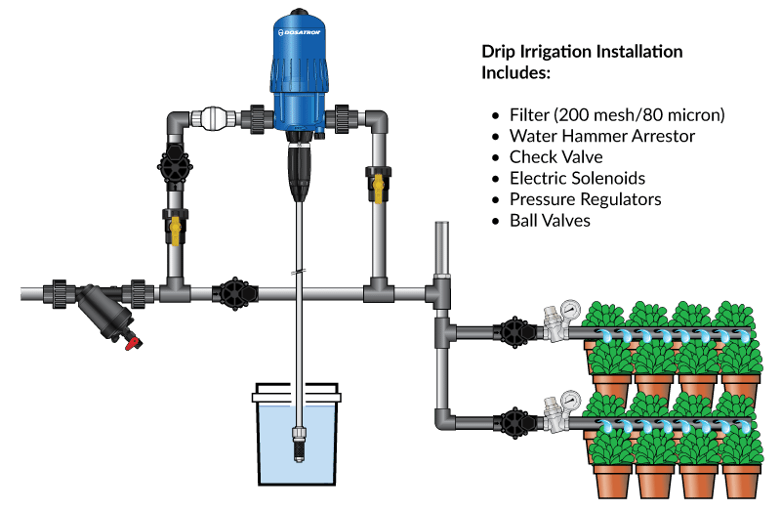
Advanced Micro-irrigation Drip line system
(Fertigator)
https://www.dosatronusa.com/essential_grid/drip-irrigation-installation/

Slide 16
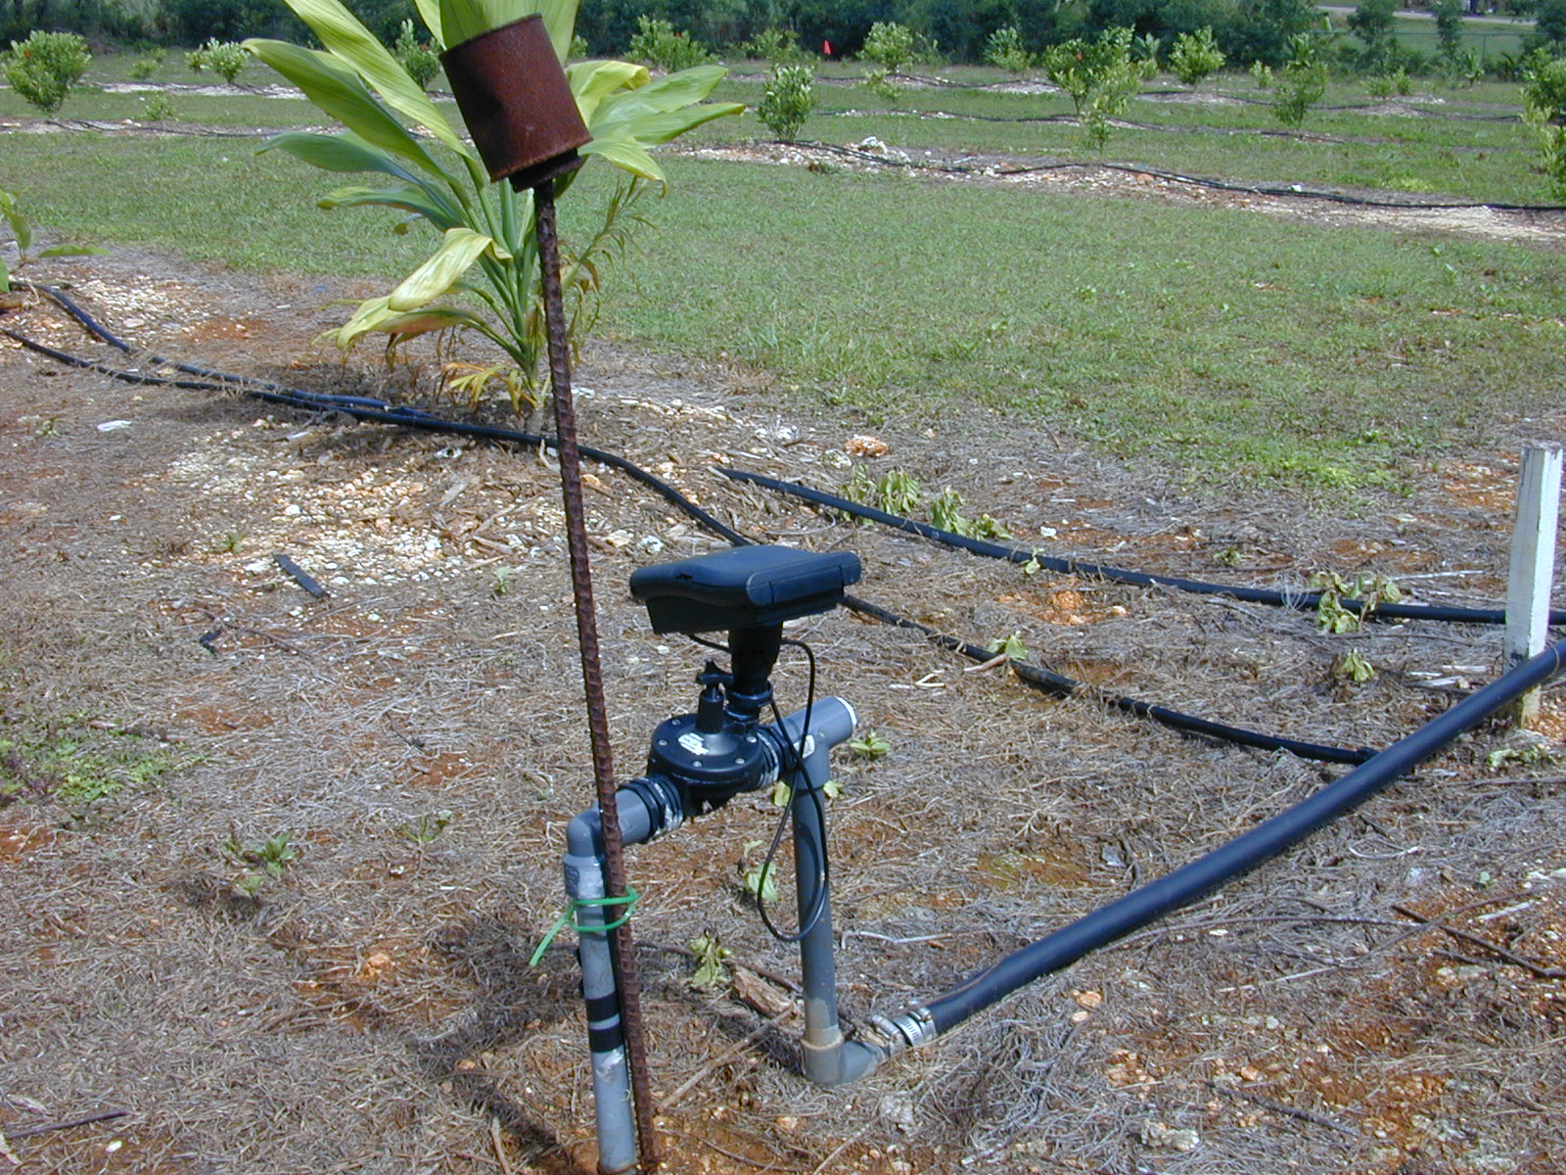
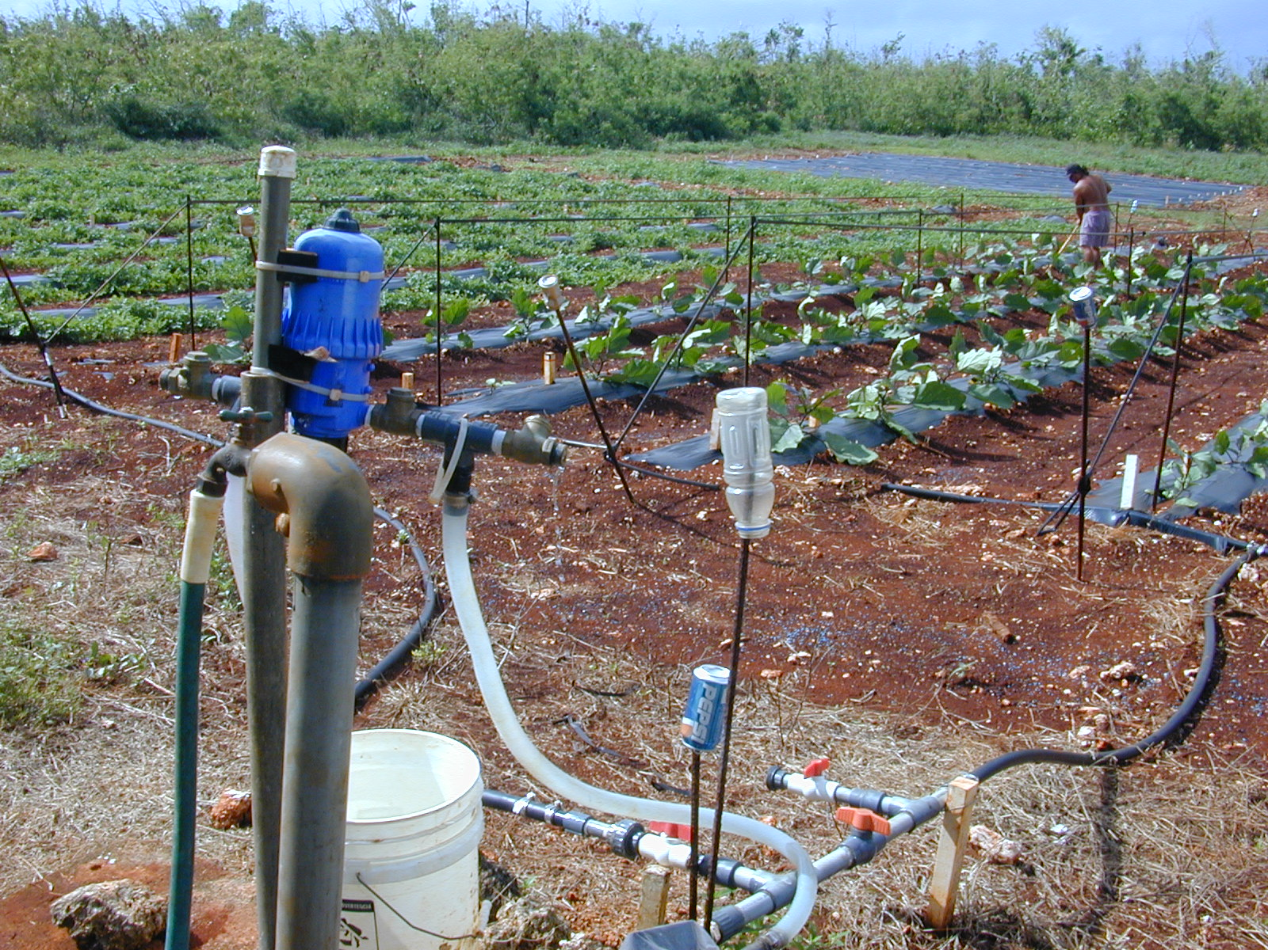
Sustainable Practices: Irrigation Management
Drip-irrigation
Even watering
Controllers
Timely watering
Fertigators
Efficient fertilizing

Slide 17
Fruit Tree Windbreaks
Primary function is wind protection
Single or multiple rows of plants strategically placed to protect an area from winds that may hinder crop & livestock production, including potential damage to structures
Tree spacing is much closer than spacing for orchard
Using fruit trees for windbreaks provides an economic return in addition to environmental protection.
Fruit yield will be reduced dramatically once the plants are mature unless irrigation and nutrients are provided along with a pruning program

Slide 18
Windbreak Design Considerations
Planning your windbreak is necessary to optimize it’s effectiveness and avoid future problems
Key physical factors:
Species
Spacing
Orientation
Height
Length
Density
Continuity

Slide 19
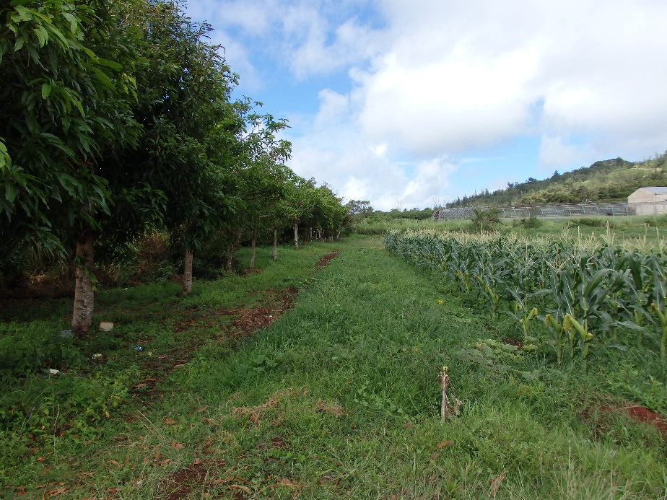
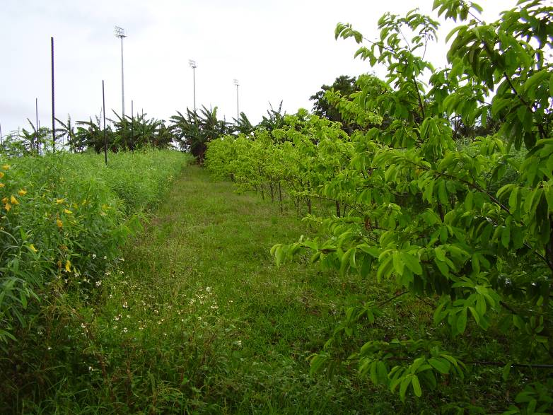
Examples of Fruit Tree Windbreak
Mango
Banana and Soursop

Slide 20
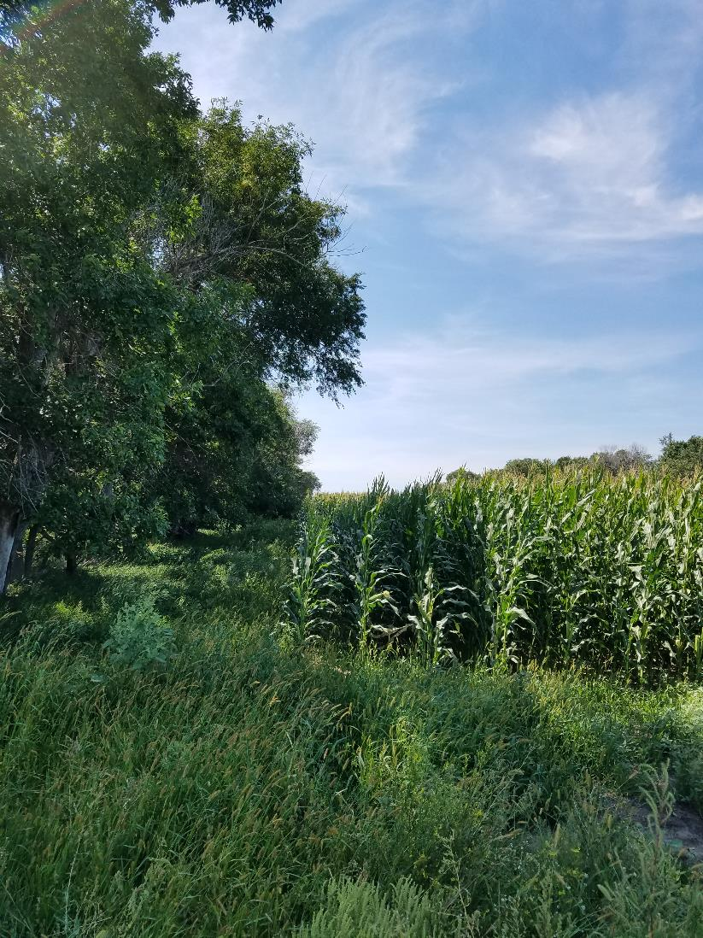
Disadvantages of Windbreaks
Over-shading
Competition
Reduction of Crop Space
Notes:
Corn field near Bismarck, ND

Slide 21
What is Contour Farming?
Farming following contour lines across sloping land
Marking the contour line
A contour line is a level line across a slope.
Contour practices help prevent soil erosion
Stops or slows downhill flow of water carrying soil particles
Marking contour lines indicate where to place barriers like:
Contour canals/ditches and berms
Orchard plantings and NFT hedgerows
NFT Vegetative barriers and filter strips

Slide 22
What is an A-frame
A simple cheap technology for marking contour lines.
Three pieces of wood assembled into an A with a plumb bob.
Once the plumb line is calibrated it shows when the two points of each leg are level.

Slide 23
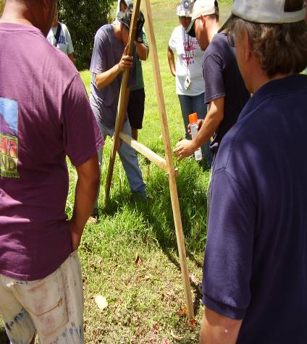
Marking the Contour
Choose a place on the slope where you would like the contour line to begin
Mark where the first leg is positioned using a stake, stone, or marking paint
Swing the second leg so that the string crosses the crossbar at the notch

Slide 24
Marking the Contour
The two points of the A-frame legs are level. This is the beginning of the contour line.
Now mark the spot where the second leg stands.
Keeping the second leg in place pivot the first leg around.
Move the first leg up or down the slope until the string aligns with the notch.
Mark the new location of the first leg and continue this process until you reach the end of the field or where you want the line to end.
The marks on the field will show a contour line across the slope.

Slide 25
Green Manures and Cover Crops
Terms green manures, cover crops, and living mulches are often used interchangeably and are.
A green manure crop is usually grown to help maintain soil organic matter and increase nitrogen availability.
Low growing annuals or bi-annuals or can be nitrogen fixing shrubs/trees managed under a “chop and drop” system like contour nitrogen fixing hedgerow
A cover crop is grown mainly to prevent soil erosion by covering the ground with living vegetation (hence living mulch) and living roots that hold on to the soil.

Slide 26
Potential Species for Guam’s Forest Gardens
Cover Crops
Green Manures
Sweet potato- Ipomea batatas
Mung bean-Vigna radiata
Cowpea- Vigna unguiculata
Perennial peanut-Arachis glabrata (acidic soils, Southern Guam)
Sunn hemp- Crotalaria juncea
Pigeon pea- Cajunus cajan
Madre de Cacao- Gliricidia sepium
Tangangtangan- Leucaena leucocephala

